Slide 1
Level 4 Project
Week 2/15
(Week 1/14 Recap)

Slide 2
Schedule for weeks 1-2 (14-15)
Complete autoencoder tuning and image pre-processing.
Deliverables:
Code for an autoencoder model
Code for pre-processing
Explanation for the choices made

Slide 3
Outlier images
This occurs when wells are impacted by a big blob (of water?)
Should they be eliminated?
Wasn’t sure if I would have to manually eliminate them,
But I was having problems with NaN and it came from pictures like this

Slide 4
Is this an outlier image?

Slide 5
Processing method code
Fixed problems
False assumption that minimum = 0.0 for all images
There’s images where this was not the case
Found this while looking through outlier images
Proper min-max normalisation fixes this
This combined with the 255-clipping was causing the NaN problems

Slide 6
Autoencoder results
Images masked out
Basic autoencoder structure
Final encoded dimensions: 24*24*8=4,608
Images masked out
Basic autoencoder structure
Final encoded dimensions: 12*12*8=1,152
Images masked out
Using PReLU over ReLU
Final encoded dimensions: 12*12*8=1,152
Notes:
c = 3
input_img = Input(shape=(imw, imh, c))
x = Conv2D(32, (3, 3), padding='same')(input_img)
x = PReLU()(x)
x = MaxPooling2D((2, 2), padding='same')(x)
x = Conv2D(16, (3, 3), padding='same')(x)
x = PReLU()(x)
x = MaxPooling2D((2, 2), padding='same')(x)
x = Conv2D(16, (3, 3), padding='same')(x)
x = PReLU()(x)
x = MaxPooling2D((2, 2), padding='same')(x)
x = Conv2D(8, (3, 3), padding='same', strides=2)(x)
x = PReLU()(x)
encoded = Flatten()(x)
x = UpSampling2D((2, 2))(x)
x = Conv2D(8, (3, 3), padding='same')(x)
x = PReLU()(x)
x = UpSampling2D((2, 2))(x)
x = Conv2D(16, (3, 3), padding='same')(x)
x = PReLU()(x)
x = UpSampling2D((2, 2))(x)
x = Conv2D(32, (3, 3), padding="same")(x)
x = PReLU()(x)
x = UpSampling2D((2, 2))(x)
decoded = Conv2D(c, (3, 3), activation='sigmoid', padding='same')(x)

Slide 7
Autoencoder structure
Simpler convolution parameters is better
PReLU performs better
Keeping reference of the papers I read to back my structure

Slide 8
Thresholding v. K-means (1/2)
Recall: I tested an image processing method where the main cells stood out
Discovered in an odd way
def mean_clip(x):
mean = np.mean(x)
return np.clip(x, mean-126, mean+127)
It worked well, but why?
126/127 could represent some variation of noise
Standard deviation is a good measure of noise
Use that:
if pixel > mean+x.std():
mask[idx] = 1

Slide 9
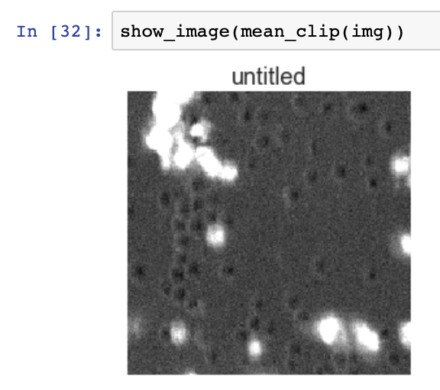
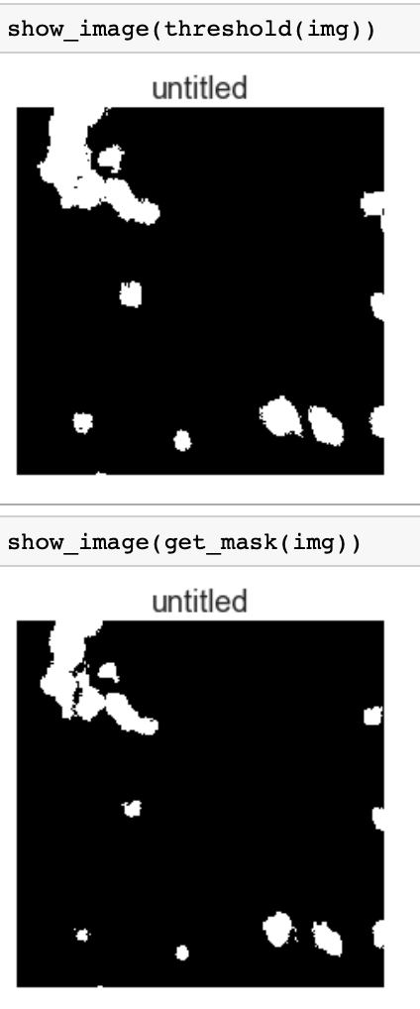
Thresholding v. K-means (2/2)
Masks are very similar.
Both satisfactory?

Slide 10
Next steps for this week
I want to try and see if I can get the blue/red clusters to separate (OVA/ConA)
Remove outlier images: maybe they impact learning
Otherwise this clustering obtained will have to do
Finalise code as needed for the deliverables
With Hannah:
Get overlap values
Organise session to sit at GE software and take notes?
Read provided articles

Slide 11
Next steps for the coming week
Use thresholding method to compare performance with K-means when masking out parts of the images.

